Slide 1

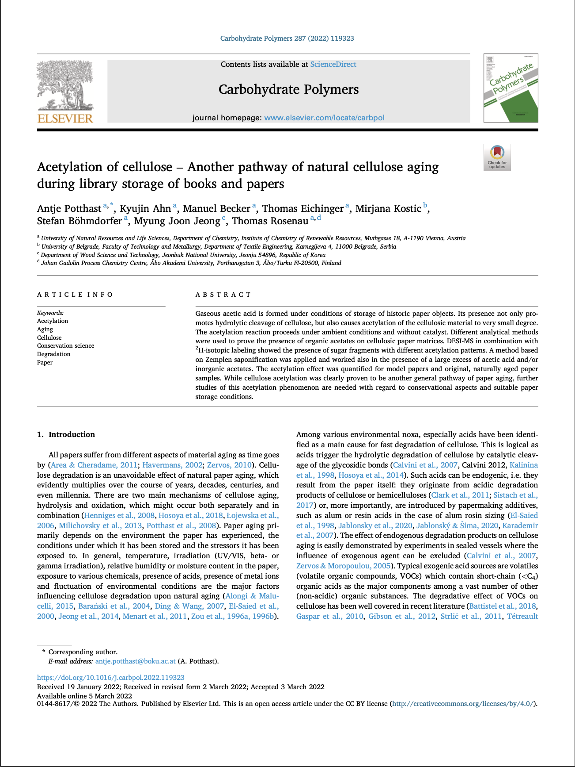

Acetylation of cellulose – Another pathway of natural cellulose aging during library storage of books and papers.
Presented By : Harshit Katariya
Roll No: 210107033
Group No: 19
Date : 13th September 2023

Slide 2
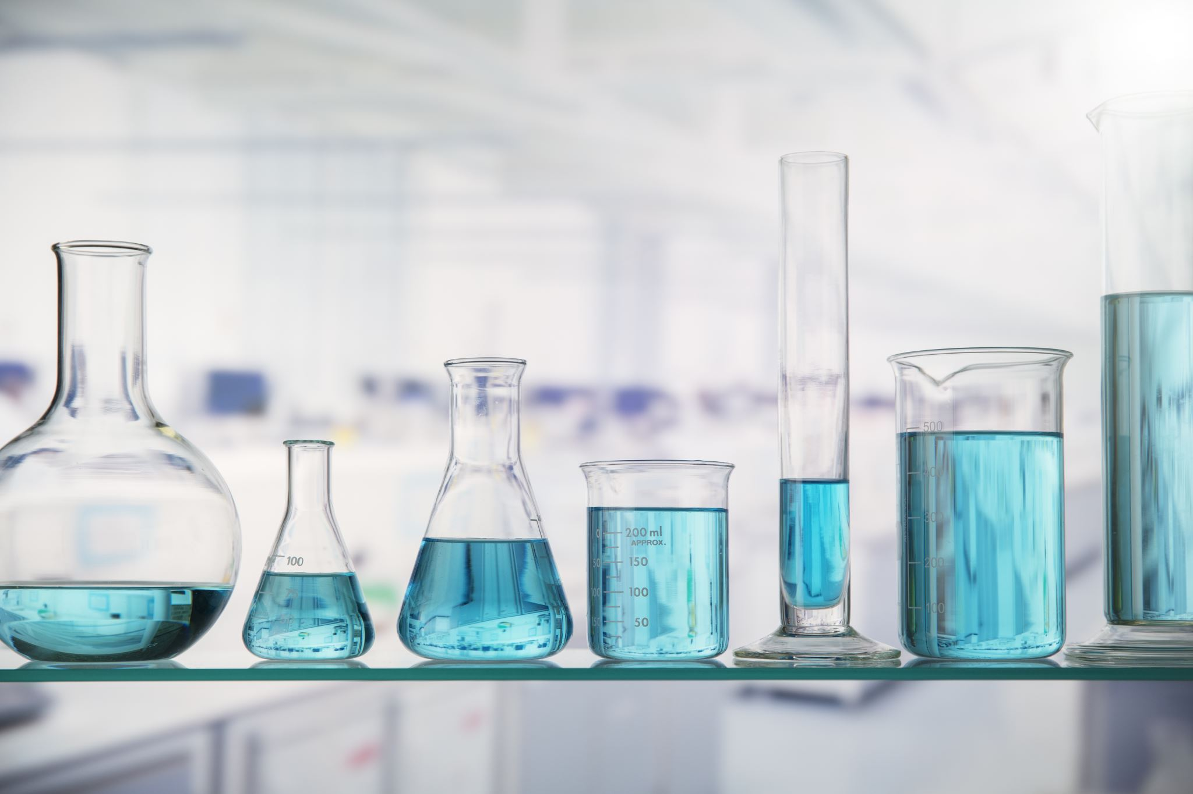
Contents
Introduction
Background
Literature Comparison
Literature Gap
Material and Methods
Results and discussion
Importance of Acetic Acid in Paper Aging
Cellulose as a Source of Acetic Acid
Acetylation of Cellulose during Aging
Evidence of Acetylation in Library Books
Implications for Preservation and Conservation
Future Research Directions
Summary
Conclusion
References

Slide 3
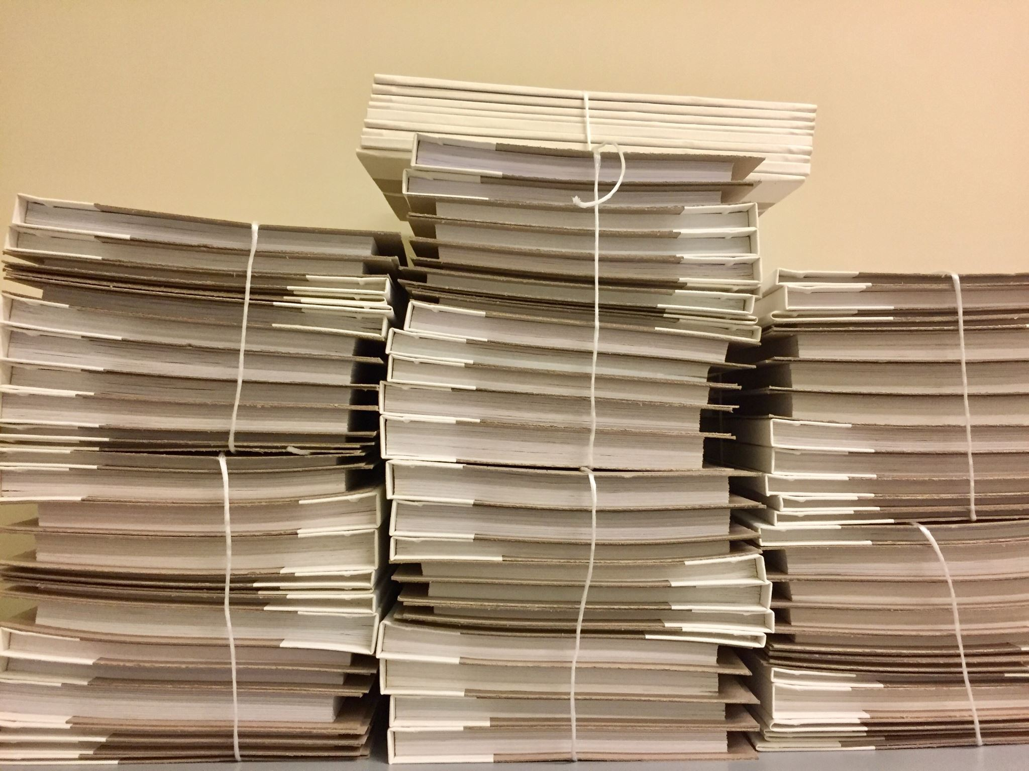
Introduction: Background
Aging is a natural process that affects all papers, causing various material degradation issues over time.
Cellulose degradation, a significant concern in paper aging, occurs through hydrolysis and oxidation mechanisms.
Environmental factors and storage conditions, such as temperature, humidity, and exposure to chemicals, play a crucial role in paper aging.
Acids, both originating from within the paper and introduced by additives, are identified as a major catalyst for cellulose degradation.
Gaseous acids, in particular, lead to increased brittleness and mechanical instability in paper, as well as surface hydrophobization.
Oxidatively stressed papers undergo chemical transformations, including the conversion of hydroxyl groups to carbonyl groups and surface hornification.
Even papers without oxidative damage can develop hydrophobic surfaces over time, contributing to their deterioration.

Slide 4

Introduction: Literature Comparison
Cellulose Degradation Mechanisms:
Extensive research on cellulose aging mechanisms, including hydrolysis and oxidation.
Investigation of how these mechanisms operate separately and interact in the aging process.
Environmental Factors:
Studies on the impact of environmental conditions such as temperature, humidity, radiation, and exposure to chemicals on paper aging.
Particular attention to the role of acids in accelerating cellulose degradation.
Acetic Acid and Esterification:
Exploration of the presence of acetic acid in the environment surrounding paper materials.
Examination of whether acetic acid can lead to cellulose surface acetylation under typical storage conditions.
Hydrophobization of Paper:
Observation of increased hydrophobicity in aging paper, linked to surface changes.
Investigation into the chemical modifications, including the conversion of hydroxyl groups to carbonyl groups, responsible for this behavior.
Quantification and Characterization:
Development of methods for quantifying and characterizing chemical changes in aged paper, including acetylation.
Efforts to identify and measure trace amounts of acetyl groups on paper surfaces.
Real-world Applications:
Consideration of practical implications of cellulose degradation and acetylation in preserving cultural heritage, especially in museums, libraries, and archives.

Slide 5

Introduction: Literature Gap
Limited Understanding of Acetylation:
Lack of comprehensive insight into how acetic acid interacts with cellulose.
Need for in-depth exploration of the reactions and mechanisms involved in cellulose surface acetylation.
Quantification Methods:
Importance of quantifying trace acetyl groups on paper surfaces.
Gap in specifying and comparing various quantification techniques.
Real-world Applications and Conservation:
Brief mention of cellulose degradation in cultural heritage settings.
Need for documented examples and case studies to illustrate the relevance of acetylation in preserving cultural heritage.
Exogenous vs. Endogenous Sources:
Mention of both endogenous and exogenous sources of acetic acid.
Gap in understanding the relative contributions of these sources to cellulose degradation.
Comparative Analysis:
Suggestion of comparing the effects of different environmental conditions on cellulose degradation.
Potential for research that quantifies and compares the impact of varying factors like humidity, temperature, and chemical exposure.
Mechanisms of Hydrophobization:
Aging paper becoming more hydrophobic.
Lack of detailed exploration of the chemical processes responsible for paper hydrophobization.

Slide 6
Methodology
Chemicals
The chemicals include acetic acid, β-D-glucopyranoside pentaacetate, dichloromethane, dry methanol, methyl acetate, sodium methoxide solution, and isotopically labeled acetic acid.
Aging
Various paper samples, ranging from 100 mg to 1 g, were exposed to glacial acetic acid vapor at different concentrations and temperatures, either in a desiccator at room temperature or in sealed ampoules at 70°C. The paper types included filter paper, pigment-containing paper, and linen rag paper, with differing post-treatment storage methods.
Post-exposure, some samples were washed to neutral pH, dried, and stored at -18°C, while others were immediately frozen at -80°C, forming distinct sets of experimental conditions.
ESI-MS analysis
A 100 mg Whatman filter paper sample was stored in a sealed vial with acetic acid for 4 weeks, using deuterated, non-deuterated, or a 1:1 mixture of both acetic acids. Afterward, a 50 mg portion of each sample underwent neutralization in 0.1 M aqueous NaHCO3, followed by washing with deionized water. The air-dried samples were then extracted with chloroform, and the extracts were evaporated and dissolved in a water/methanol mixture before mass spectrometry analysis.
Mass spectra of the resulting solution were obtained using an Agilent 6320 XCT Ion Trap MS, operating in positive mode with specific settings for capillary voltage, source temperature, and nitrogen gas flow. The scan range was 50–500 m/z in profile mode.

Slide 7

Methodology
GC–MS analysis with solid-phase microextraction (SPME)
GC–MS analysis was conducted using an Agilent 7890A gas chromatograph coupled with an Agilent 5975C triple axis mass selective detector (MSD). The GC had both multimode and split− /splitless inlets.
For methyl acetate analysis, a VF-WaxMS column was connected to the multimode inlet and the MSD. The split− /splitless inlet was used for fiber conditioning. A fused silica capillary was connected to the split− /splitless inlet to maintain helium carrier gas pressure.
The GC operating conditions included specific temperature gradients, constant column flow, and an electron ionization mode (EI-mode) for the MSD. Data acquisition was performed in SIM mode for the detection of methyl acetate and its carbon-labeled derivative. The SPME process was automated using a CTC-PALxt autosampler controlled by Chronos software, and Carboxen/PDMS SPME fibers were used.
Optimized standard procedure for accurate acetylation analysis
A stock solution (Stock Solution A) was prepared by dissolving 10 mg of 4-O-(13C2-acetyl)-vanillin, an internal standard, in 4 mL of anhydrous methanol.
For sample analysis, approximately 2 mg of cellulose or paper sample was placed in a 1.5 mL vial. To each sample, 50 μL of anhydrous methanol and 20 μL of Stock Solution A were added. Additionally, 300 μL of sodium methanolate (0.5 M in MeOH) was introduced before sealing the vials with 1.3 mm silicon/PTFE septa crimp caps. These prepared samples were promptly used for GC–MS analysis.

Slide 8
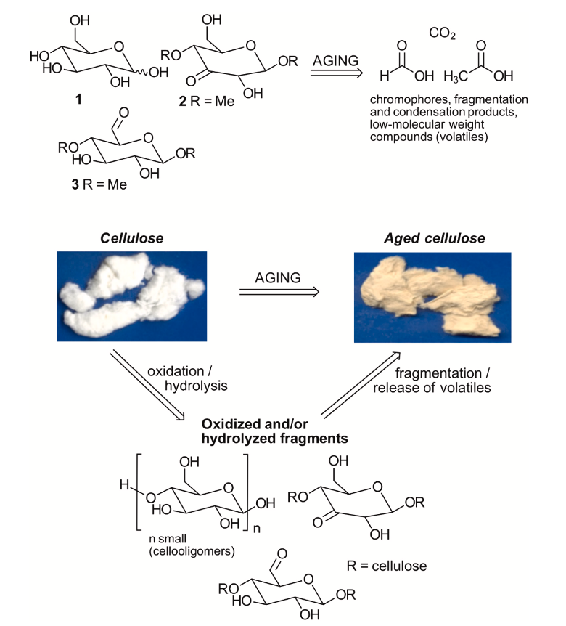
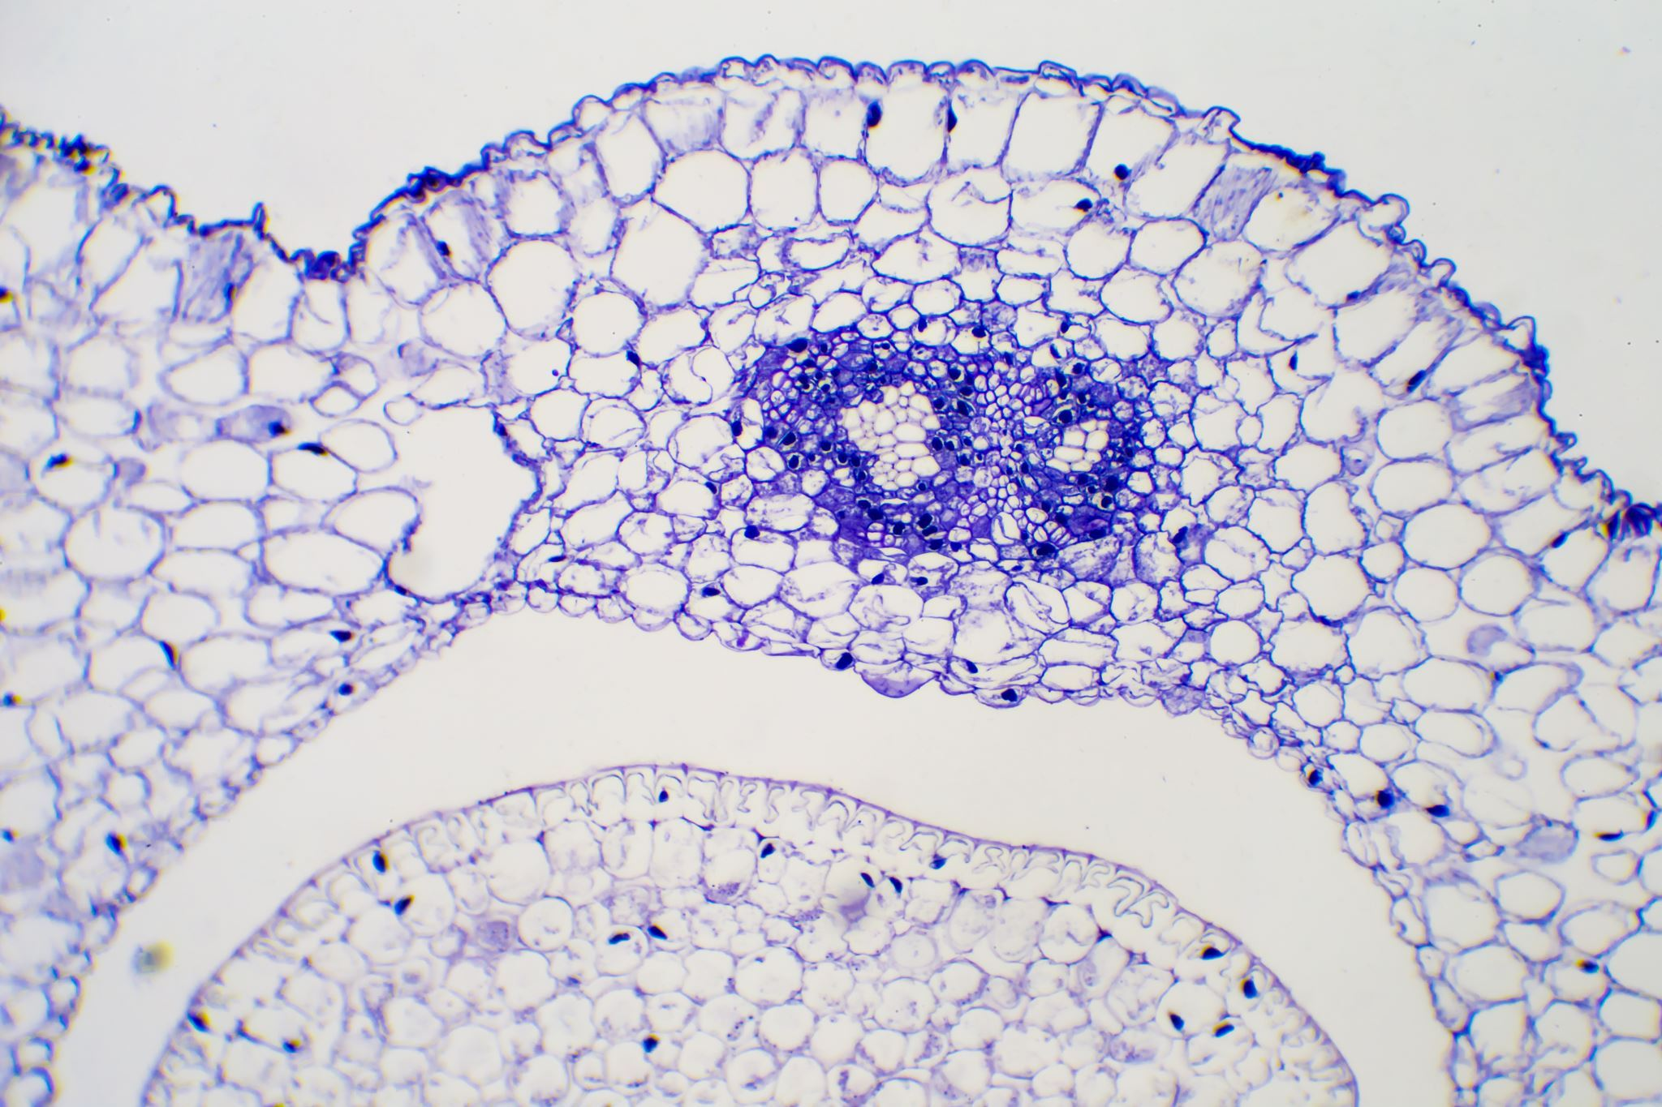
Results and discussion
Importance of Acetic Acid in Paper Aging:
Acetic acid is a significant concern in paper aging.
It is one of the most abundant volatile organic compounds (VOCs) found in indoor air and is particularly prevalent in environments with wood and paper materials.
Acetic acid originates from various biological and synthetic sources, with wood and plants being primary contributors.
Wooden structures, such as particle boards and drawers, are major sources of acetic acid fumigation in storage areas for cellulosic objects.

Slide 9

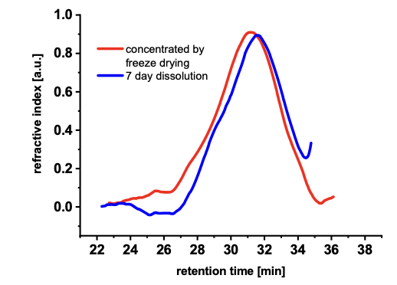
Cellulose as a Source of Acetic Acid:
During the aging of cellulose-based materials like paper, cellulose itself can generate small amounts of acetic acid.
This acetic acid production occurs through hydrolysis and oxidation processes, which transform cellulose into volatile degradation products.
Conditions such as acidity, alkalinity, or oxidative environments can accelerate the formation of acetic acid from cellulose.
While cellulose, in its pristine form, may produce trace amounts of acetic acid, its transformation into lower-molecular fragments, such as oligomers and monomers, is a prerequisite for substantial acetic acid generation.

Slide 10
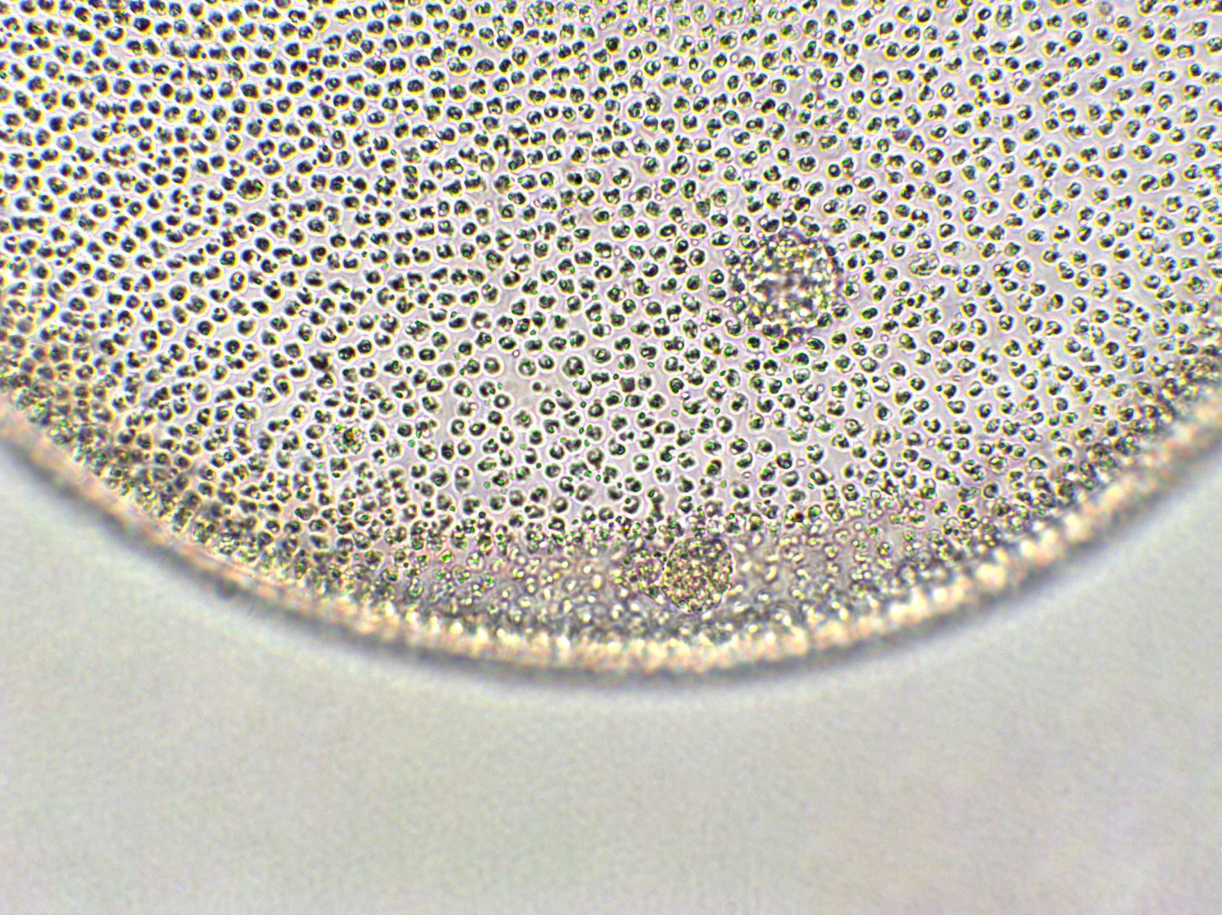
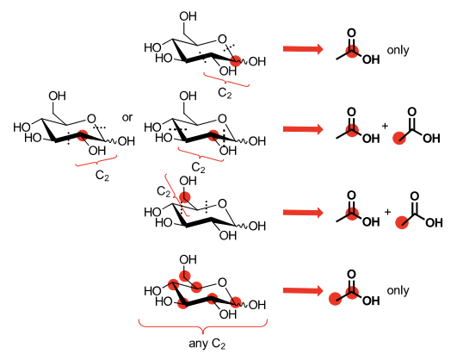
Acetylation of Cellulose during Aging:
Natural aging conditions can lead to the acetylation of cellulose in paper and other cellulosic materials.
Surface-confined water in cellulose, known as "non-freezing water," can serve as a reaction medium for acetylation, even under ambient conditions.
The degree of acetylation, despite being low on average, can significantly impact the macroscopic properties of paper, affecting its hydrophobicity and overall behavior.
Detecting and quantifying trace acetylation in paper is challenging but feasible using sensitive analytical methods that differentiate between organic acetates and free acetic acid or acetate salts.

Slide 11
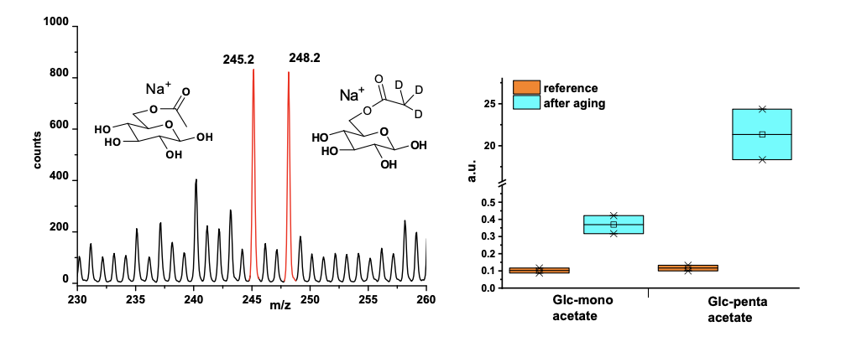

Evidence of Acetylation in Library Books:
Analysis of books stored in libraries for varying durations (ranging from 35 to 109 years) showed evidence of cellulose acetylation.
The degree of acetylation increased with longer storage times, indicating ongoing acetylation processes in these materials.
Acetylation degrees were quantified based on the number of acetyl groups per anhydroglucose unit, with values ranging from one acetylated hydroxyl group in 170 to 4,800 units, depending on the age of the book.

Slide 12
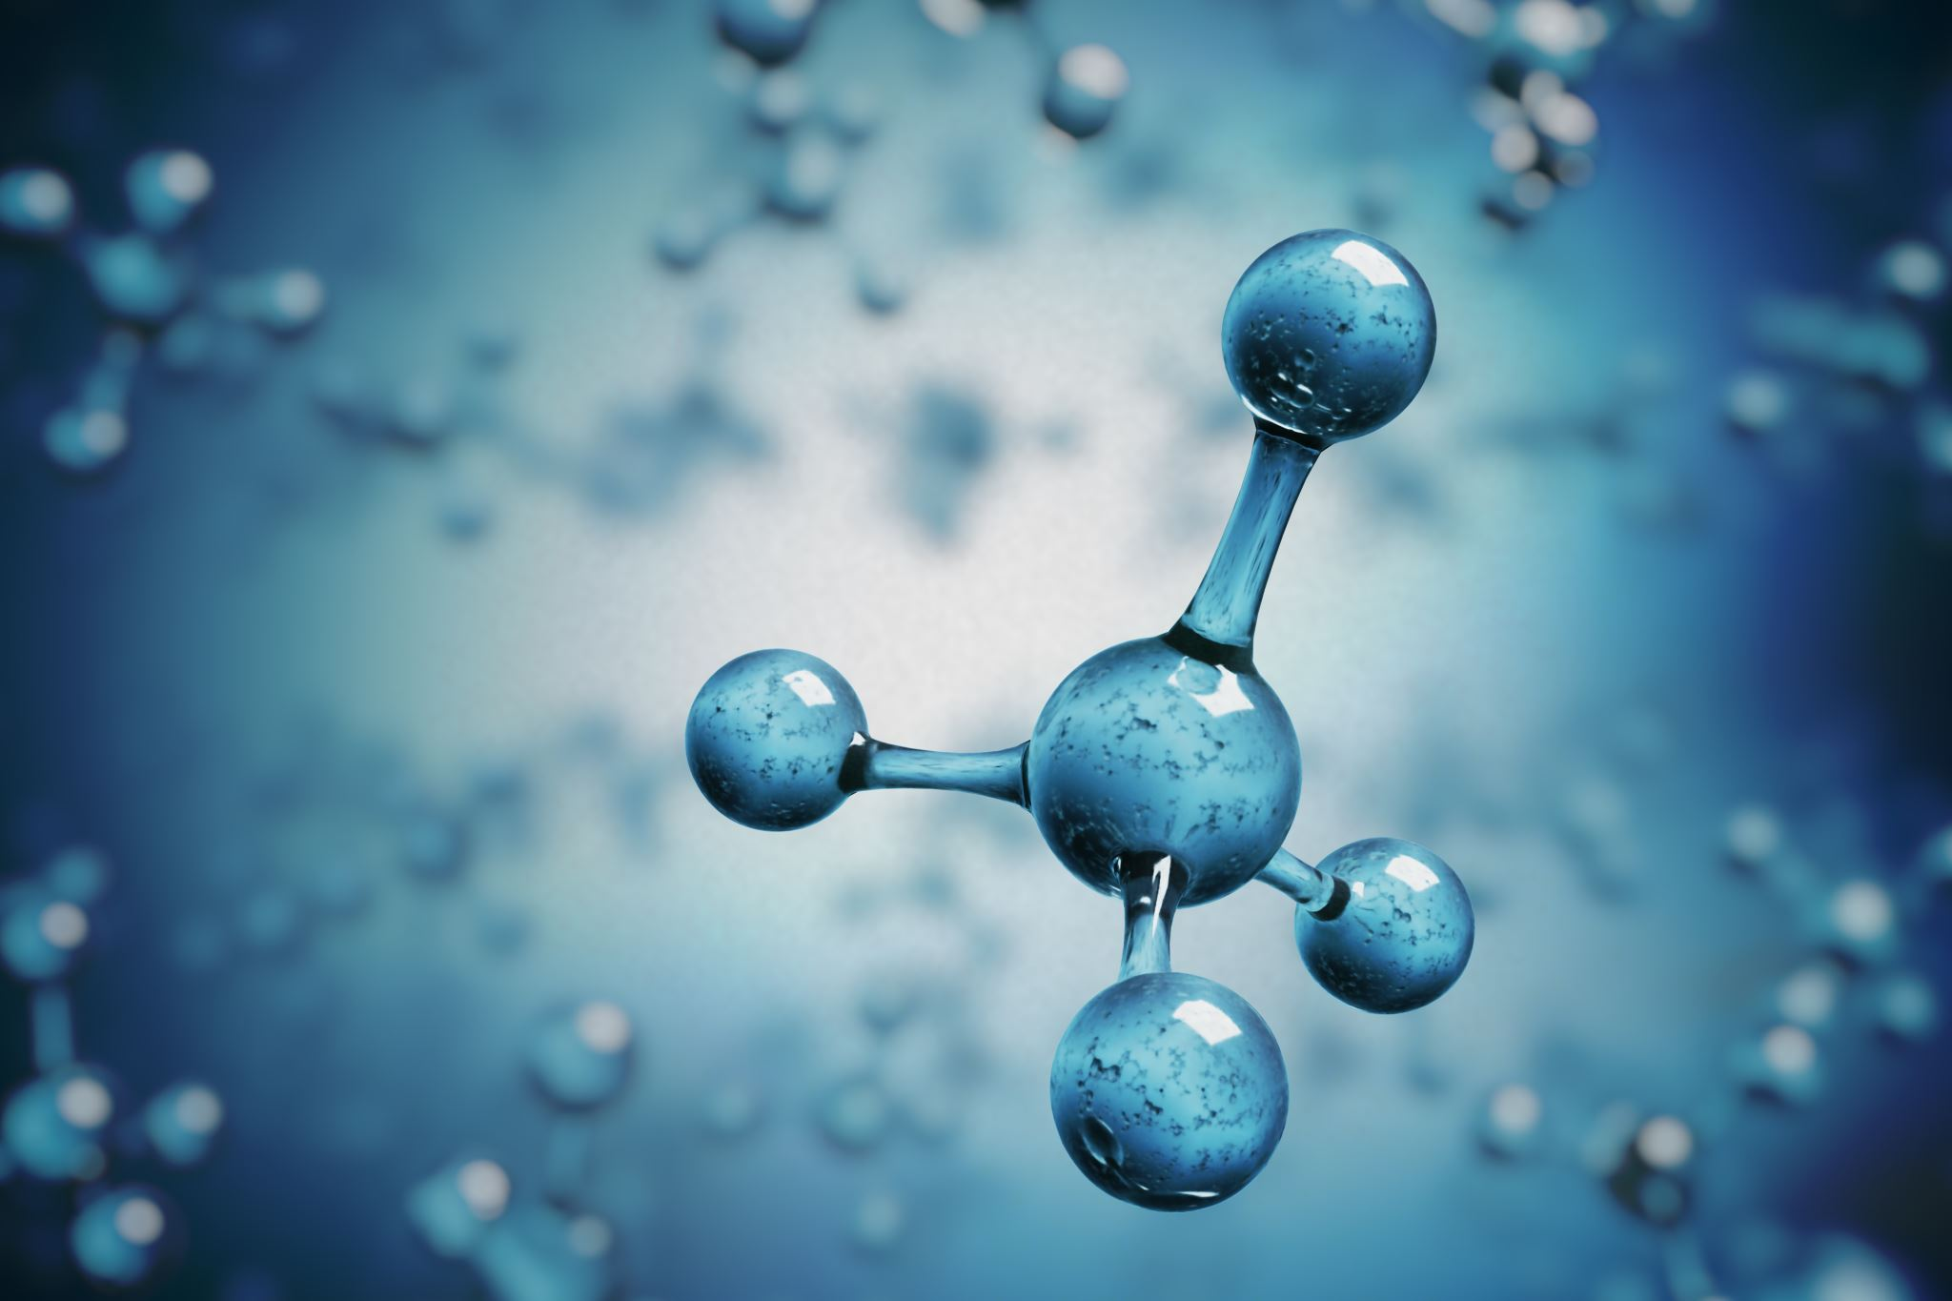
Implications for Preservation and Conservation:
The presence of acetic acid and the potential for cellulose acetylation in aged paper and cellulose-based artifacts highlight the importance of preservation and conservation efforts.
Preservationists and conservators must consider the long-term effects of acetic acid exposure on the stability and integrity of historic documents, artworks, and artifacts.
Strategies may include controlling storage conditions, limiting exposure to acidic environments, and employing conservation techniques to mitigate the impact of acetic acid on cellulose materials.

Slide 13

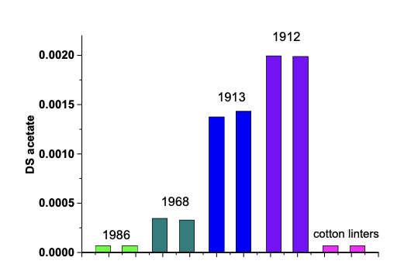
Future Research Directions:
Further research is needed to deepen our understanding of cellulose acetylation, especially under ambient aging conditions.
Investigating the mechanisms, kinetics, and factors influencing acetic acid production and cellulose modification will enhance our ability to predict and manage these processes.
Developing non-invasive or minimally invasive analytical methods for detecting trace acetylation in historic materials can aid in assessing their condition and informing preservation decisions.
Collaborative efforts among scientists, conservators, and archivists are essential for advancing knowledge in this field and preserving cultural heritage for future generations.

Slide 14

Summary:
Acetic acid, a common airborne compound in environments with wood and paper, plays a crucial role in the aging of cellulose-based materials.
Cellulose itself can serve as an endogenous source of acetic acid during aging, contributing to trace acetylation.
Evidence of cellulose acetylation was found in naturally aged library books, with increasing acetylation degrees observed over time.
Detecting and quantifying trace acetylation in cellulosic materials is essential for understanding their aging processes and developing preservation strategies.

Slide 15

Conclusion
Acetylation of cellulose in paper occurs during natural aging, particularly in environments like museums, libraries, and archives, confirming the initial hypothesis of low-level surface acetylation as a general pathway in paper aging.
The degrees of substitution for acetyl groups in aged paper are relatively minor, with values ranging from 0.008 to 0.00007, corresponding to one acetyl group per 30 up to several thousand anhydroglucose units.
This chemical alteration, albeit minute, can be unequivocally detected and quantified using the described quantification approach, shedding light on cellulose degradation.
The physical properties of paper are affected by acetylation, including changes in extractability and hydrophilicity/hydrophobicity. Additionally, other conservation-related impacts, such as interactions with ink, print, pigment mobility, and metal ion complexing, may occur but require further study.
The gas phase acetylation is an ongoing process influenced by factors like the concentration of acetic acid in the surrounding atmosphere. The balance between endogenous and exogenous contributors to acetic acid formation remains uncertain, emphasizing the need for more research to assess and optimize storage conditions and their impact on paper acetylation.

Slide 16

References
Ahn, K., Rosenau, T., & Potthast, A. (2013). The influence of alkaline reserve on the aging behavior of book papers. Cellulose, 20(4), 1989–2001.
Ahn, K., Zaccaron, S., Zwirchmayr, N. S., Hettegger, H., Hofinger, A., Bacher, M., Henniges, U., Hosoya, T., Potthast, A., & Rosenau, T. (2019). Yellowing and brightness reversion of celluloses: CO or COOH, who is the culprit? Cellulose, 26(1), 429–444.
Alongi, J., & Malucelli, G. (2015). Thermal degradation of cellulose and cellulosic substrates. In A. Tiwari, & B. Raj (Eds.), Reactions and mechanisms in thermal analysis of advanced materials (pp. 301–332).
Area, M. C., & Cheradame, H. (2011). Paper aging and degradation: Recent findings and research methods. Biological Research, 6(4), 5307–5337.
Bai, X., Johnston, P., Sadula, S., & Brown, R. C. (2013). Role of levoglucosan physiochemistry in cellulose pyrolysis. Journal of Analytical and Applied Pyrolysis, 99, 58–65.
Baran ́ski, A., Dutka, D., Dziembaj, R., Konieczna-Molenda, A., & Łagan, J. M. (2004). Effect of relative humidity on the degradation rate of cellulose. Methodology studies. Restaurator, 25(1), 68–74.
Barton, D., Ralph, R., & Kane, K. (1968). The dissociation of acetic acid dimer in the gas phase. Journal of Chemical Education, 45(6), 440–441.

Slide 17
Thank you

